Slide 1

Handwritten digital recognition model

Slide 2
ABOUT THE MODEL
Purpose Of The Model: The model is designed to automate the recognition of handwritten digits, enhancing computational image processing capabilities.
Application In Machine Learning: It is extensively used in automated postal mail sorting systems to efficiently sort mail by recognizing postal codes.

Slide 3
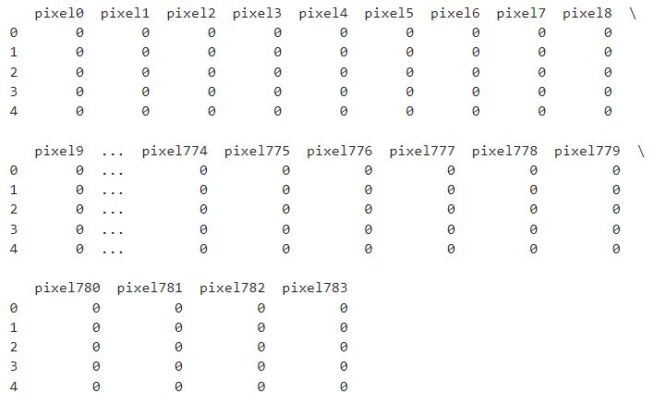
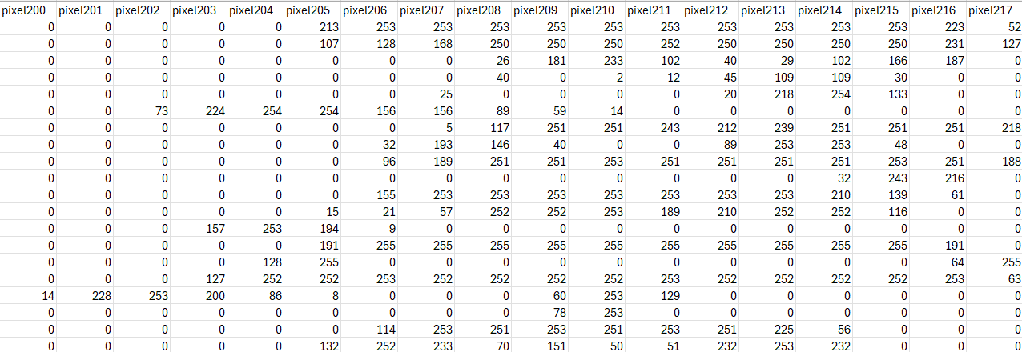
DATASET USED
The dataset for this analysis was imported from the sklearn library’s dataset collection.
digits.data : Array of 1797 samples where each sample has 64 features (flattened from 8x8 pixels).
digits.target : Array of 1797 labels corresponding to the digit in each image.
Features:Each of the 64 features is a pixel value ranging from 0 (white) to 255 (black).

Slide 4
DATA PREPROCESSING
Data Loading: The dataset is loaded from the sklearn.datasets module, specifically the digits dataset which contains images of handwritten digits.
Splitting the Data: The data is divided into 80% training and 20% testing sets using the train_test_split function. This helps in validating the model’s performance on unseen data, crucial for assessing its generalization capability.

Slide 5
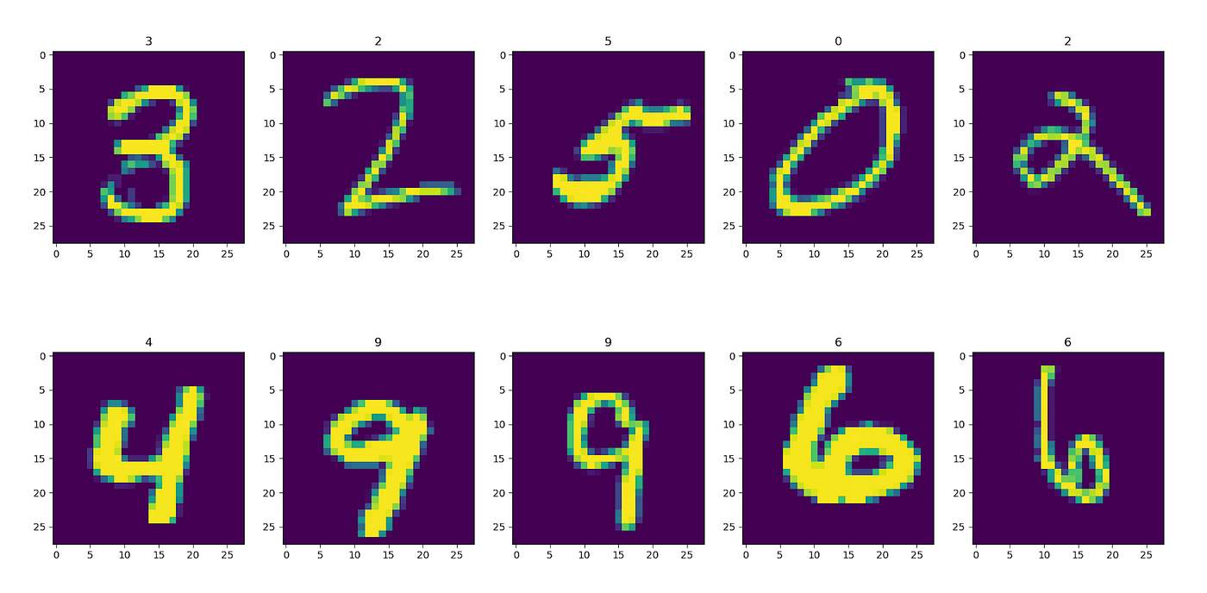
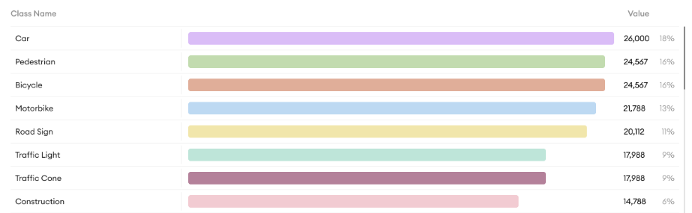
EXPLORATORY DATA ANALYSIS (EDA)
Visualization of Sample Images: Plots digit images to show variability and complexity, essential for understanding input data format.
Class Distribution: Visualizes class distribution to check for imbalances that could impact model learning and generalization.

Slide 6
ALGORITHM USED
The algorithm used in the model is the Random Forest Classifier.
Robustness to Overfitting: Random Forest mitigates overfitting by averaging multiple decision trees, enhancing general model reliability.
Effectiveness with Non-Linear Data: Handles complex, non-linear relationships between features well, suitable for high-dimensional data like images.
Minimal Preprocessing Required: Operates efficiently without the need for input normalization, simplifying the preprocessing stage.

Slide 7
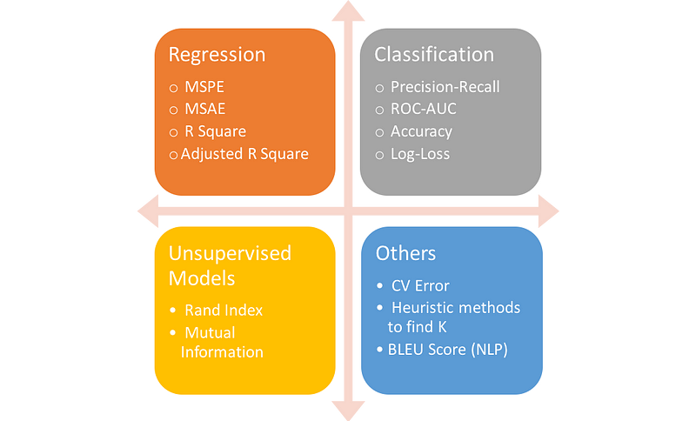
MODEL PERFORMANCE
Overall Accuracy of 97.22%: Indicates robust performance in correctly identifying handwritten digits across tests.
Exceptional Accuracy for Digits 0, 2, 3, 4: Some digits achieve perfect precision or recall, showcasing model reliability.
Consistent High Performance Across Digits 1, 6, 7, 8, 9: Maintains strong precision and recall, ensuring reliable classification.
Confusion Matrix: It visualizes the accuracy of predictions and highlights where the model misclassifies digits.

Slide 8
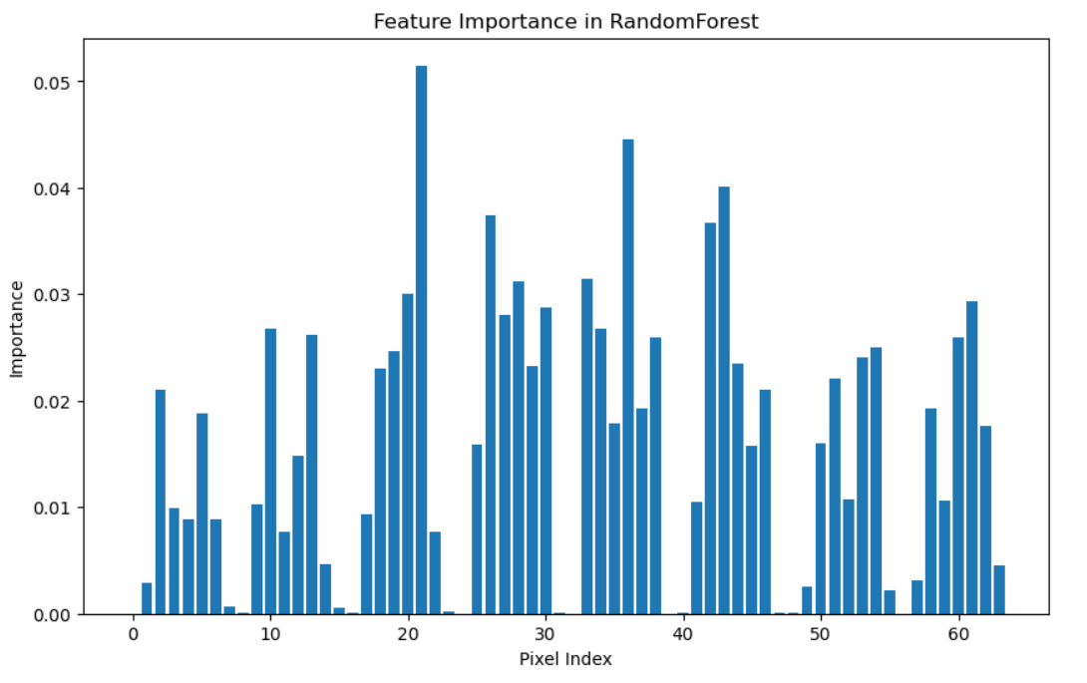
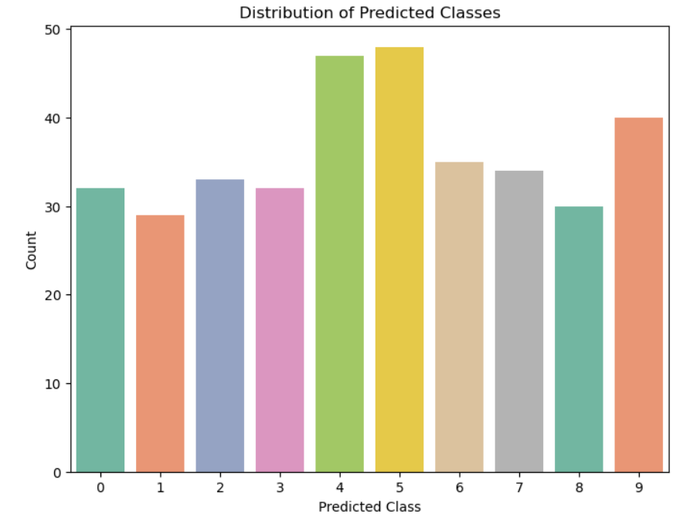
PLOT INTERPRETATION
Feature Importance:
Pixel Importance Variability: Significant differences in pixel importance, with central pixels being most influential.
Central Pixel Emphasis: Pixels around indices 20-30 and 40-50 are crucial for accurate digit classification.
Edge Pixels Less Critical: Lower importance at image edges suggests minimal contribution to model decisions.
Distribution of Predicted Class:
Varied Prediction Frequency: Chart shows uneven distribution; digits 4 and 5 are most frequently predicted.
Possible Model Bias: High counts for digits 4 and 5 suggest a potential bias toward these classes.
Indication of Class Imbalance: Lower prediction counts for digits 0, 6, and 8 may signal class imbalance issues.

Slide 9



